Slide 1

Session 1 Knowledge Check

Slide 2

Welcome to Session 2
Clean, Transform and Load Data in Power BI

Slide 3
Power Query
Overview of Power Query
Power Query is a data connection technology that enables you to discover, connect, combine, and refine data across a wide variety of sources.
Seamlessly integrated into Power BI for data transformation and preparation.
Key Features
Data Import: Connect to various data sources such as Excel, SQL Server, and more.
Data Transformation: Clean and shape data using a user-friendly interface.
Query Editor: Use the Query Editor to perform complex data transformations without coding.

Slide 4
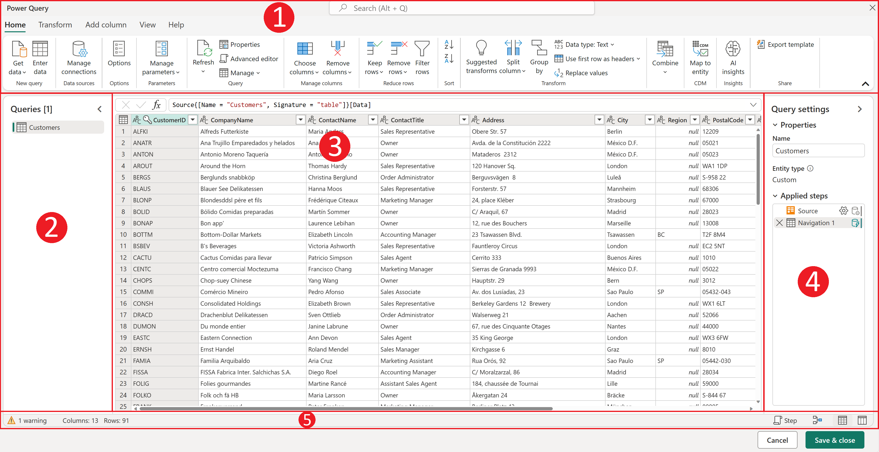
1) the ribbon, 2) the queries pane, 3) the data view, 4) the query settings, and 5) the status bar

Slide 5
Why Data Transformation is essential in Power BI
Ensuring Data Accuracy
Enhancing Data Quality
Preventing Inaccurate Insights
Ensure Data is Structured
Maintaining Data Consistency
Optimizing Resource
Enhance Data Collaboration

Slide 6

Basic Data Transformation Techniques in Power BI
Data Type Conversion
Filtering Data
Merging and Append Queries
Aggregating Data
Replace Values
Handling Missing Values
Column Management

Slide 7
Knowledge Check

Slide 8

https://ahaslides.com/A17CZ

Slide 9
What is the purpose of Power Query in Power BI?
To create and manage data models
To analyze and visualize data
To import, transform, and combine data from various sources
To create custom visuals for data visualization
Which one of the following features are used to track, re-order or delete the steps completed in Power Query?
Applied Steps
Properties
New Source
Queries
Which of the following is a valid method to handle null values in Power Query?
Use the "Remove Nulls" operation
Use the "Replace Values" operation to substitute nulls with a default value
Use the "Filter Rows" operation to exclude nulls
Use the "Split Columns" operation to separate nulls

Slide 10
Which feature allows you to add rows of different data sources together in Power Query?
Grouping
Merging
Appending
Removing Data
Which operation in Power Query can help in reducing the data size by aggregating information?
Remove Duplicates
Group By
Split Columns
Unpivot Columns

